Slide 1

YTP Arduino – Lesson 3
Aug 2018

Slide 2
Goals
To understand what a breadboard is
To understand how breadboards work
To build the blink circuit with a breadboard
Success Criteria
Answer questions about the workings of a breadboard
Complete a working circuit on a breadboard

Slide 3
What is a Breadboard

Slide 4
Circuit on an “original” breadboard (image courtesy of mischka and their awesome literal breadboard tutorial)

Slide 5
An electronics breadboard (as opposed to the type on which sandwiches are made) is actually referring to a solderless breadboard.
These are great units for making temporary circuits and prototyping, and they require absolutely no soldering.

Slide 6
A Soldered Circuit Board

Slide 7
How to use a Breadboard

Slide 8
How to use a Breadboard
Positive and Negative (GND or Ground) Rails

Slide 9
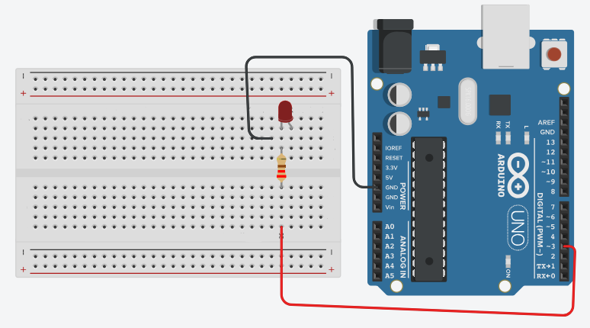
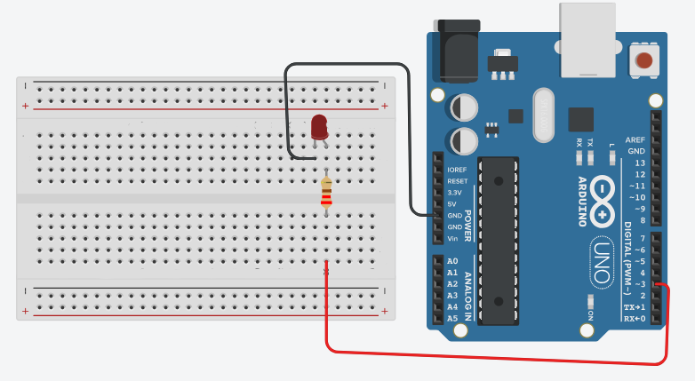
Blink with a Breadboard
Will both of these work ?
WHY ???

Slide 10
Building Blink
Connect a jumper to PIN 4 in the Arduino
Connect the other end of the jumper to somewhere in the middle of the breadboard
Connect one end of another jumper to GND in the Arduino

Slide 11
Building Blink
4. Connect a resistor across the bridge of the breadboard but in line (connected to) the first jumper (the one in PIN 4).
5. Connect and LED in line with the resistor. The positive (long) leg should receive current from the resistor. The short leg should be placed in a different column of holes.

Slide 12
Building Blink
6. Finally, connect the jumper wire to the short leg of the LED.
THIS SHOULD COMPLETE THE CIRCUIT !!
NOW CHECK THE CURRENT FLOW!

Slide 13
Current Flow
-
+

Slide 14
Coding the Circuit
Open Arduino
Plugin your Arduino
Check your board
Check your port
Open the Blink sketch
Upload the Blink sketch
Run the Blink sketch

Slide 15
Homework
Watch the following video:
The Learning Circuit – Circuit Basics
bit.ly/ytp01-basic-circuits

Slide 16


